Slide 1
Simulating sports videography in a controlled environment
MAE 5070 Robot Perception
Final Project
By: Madhav Gupta (mg967)

Slide 2
Motivation
I am a Formula1 fan, and I play with remote control cars at home in my free time. I have always been intrigued how Formula 1 is filmed with different angles. What if I could film my own remote-control cars inside my room, in two different angles, automatically.
Therefore, I decided to put two cameras on the roof of the room and design them to track the position of a small car that would be on the ground.

Slide 3
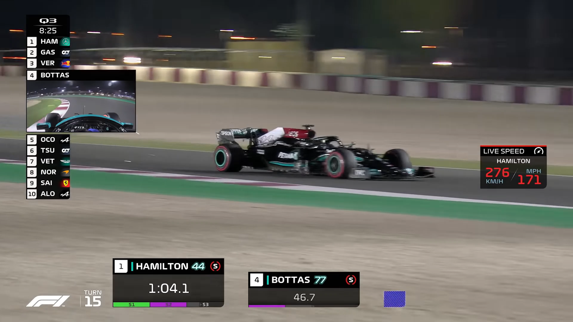
Real life Scenario
In the given video, chain of events are:
Cameraman detects the target (Car)
The car is tracked through the corner
When the car leaves the field of view of first camera, the second camera picks it up.
Second camera tracks the car
Meanwhile, the cameraman moves the first camera for the next camera.
Please play video
https://drive.google.com/file/d/1rRldNV8jN8mPhgRmFHz8JglxyZsAj2JJ/view?usp=sharing

Slide 4
Problem Statement
To track the cars (targets) automatically, without the need of a cameraman. Maximize the time the target is tracked, given the constraints of camera. Shift the focus to second angle and start tracking the next target in a controlled environment.

Slide 5
Simulated Scenario
A room with relevant dimensions is assumed. The cameras are placed on the roof, equally spaced from opposing walls. The camera which tracks the target is the leading sensor and the other camera is the lagging sensor.
In the absence of a target, the cameras have a specified tilt angle. They are rotating by temporally changing their pan angle. Pan angle has a phase shift of 90 degrees between the two cameras.
The target is moving in a semi-circular fashion. The leading camera is the one which detects the target and tracks it until the target is in FOV of the lagging camera. Subsequently, the leading camera looks for other target by backtracking to its original state of rotation.

Slide 6
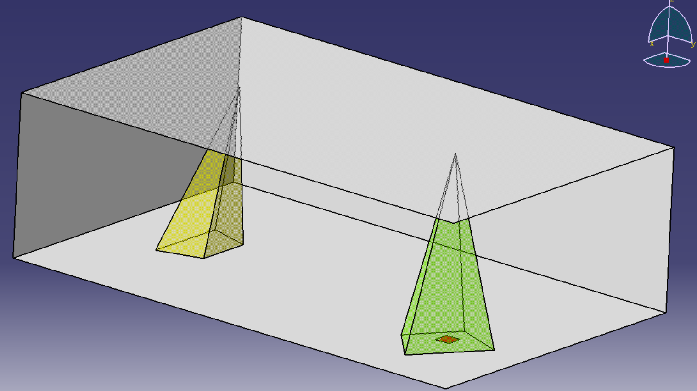
Setup
Size of Room:
8 m length
5 m wide
2.5 m height
Camera Parameters
Size of sensor:
a=23.5mm
b=15.6mm
Focal length: 50 mm
Taken from a Nikon D3400
Camera States and constraints:
Pan Angle: Ψ ϵ [0, 2Π]
Tilt Angle: Φ ϵ [-7Π/9, 7Π/9]
Target Characteristics
Non-linear Semi-circular movement
Speed – 0.5 m/s

Slide 7
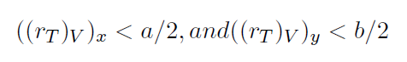
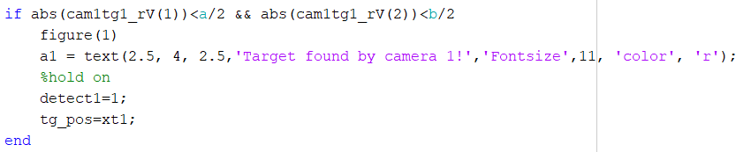
Methods - Detection
The location of target was determined by using transformation vectors.
Relative position of target in the virtual image plane should be less than the size of the sensor:
If the target is found, the detection input is set to 1 and the leading sensor registers the position of the target.

Slide 8
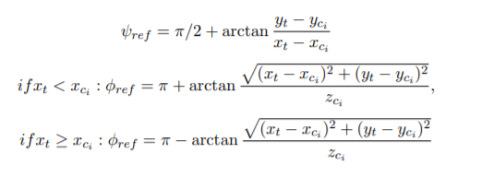
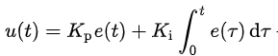
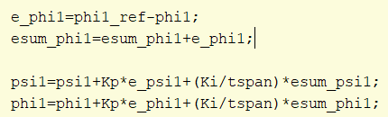
Methods – Tracking by Leading sensor
After the camera registers the position of the leading target, desired states of the camera are calculated.
A Proportional-Integral controller was used for tracking:

Slide 9
Methods – Tracking by Lagging Sensor
When the target is detected by the leading sensor, it sends the position of the target to the lagging camera. The lagging camera adjusts its position according using a PI control (just like in the leading sensor).
Mechanical constraints on the pan and tilt angles of the camera stop it to reach the target, especially if the target is far away.

Slide 10
Methods – Backtracking
Backtracking here means the camera comes back to its initial input states.
In this case, it occurs after the leading camera loses the target to the lagging sensor. Aim of the leading camera is to look for the next target.
When the sensor loses the target, it registers its current states and temporally iterates back to the original state using a proportional controller.

Slide 11
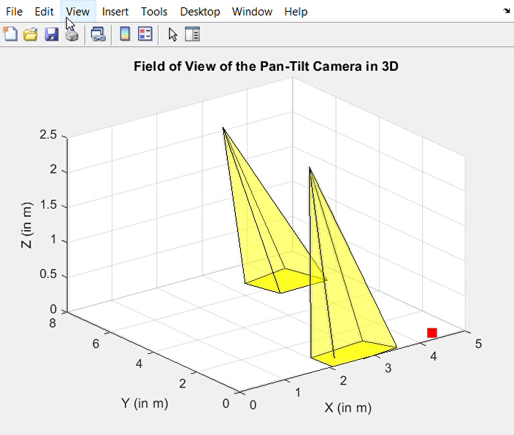
Please play video
https://drive.google.com/file/d/1i6yRtlJfQINUcq6tet8oKq1T67Pq4ZnI/view?usp=sharing

Slide 12
Cases
Detection cases for the cameras are:
Camera 1 (Leading) | Camera 2 (Lagging) | Result
0 | 0 | Constant Tilt for both cameras, both cameras are rotating.
1 | 0 | Camera 1 detects and starts tracking, communicates location to camera 2 and it starts tracking in its constraints.
1 | 1 | Both cameras detected and are tracking the target until the target leaves the constraints of camera 1 (leading camera).
0 | 1 | Camera 2 continues to track until the target is in its constraints. Camera 1 backtracks.

Slide 13
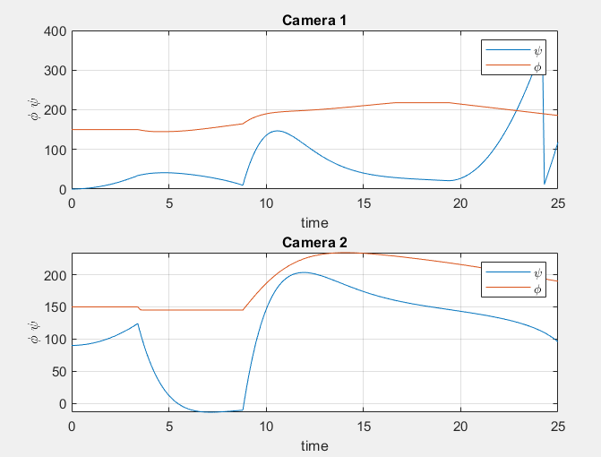
Results
PI controller is smoothing the tracking procedure
The solution is maximizing the time the target is being tracked given the constraints of the camera.
Camera1:
Pan and tilt remain within given constraints.
Sudden drop in pan angle at t=23sec because it reached its max constraint and starts from zero
The leading camera (1) detects the target at t=3seconds. Until that point, the cameras are rotating, as the pan angle is increasing, and tilt angle is constant.

Slide 14
Advantages
The methods demonstrated in this project have the following advantages:
Implementation potential in sports production
Asymmetrical tracking is more efficient than symmetrical tracking as the leading camera is looking for other targets when it loses the first target from its field of view.
PI controller method is robust and smoothens state variables according to motor constraints.

Slide 15
Possible future work
More than two cameras can be used for better perspective
Environmental conditions can be harsher, like fog or just white noise.
Use object classification through one of the following methods:
Object Cascade
SVM
RCNN

